Slide 1

WP4: Dissemination Work Package
Ruba Hasan
Faculty of Engineering
Jordan University of Science and Technology (JUST)
Presenter Logo

Slide 2
Outline
About WP4.1
Responsible Partners
Time Frame of WP4.1
Events

Slide 3
About WaSec Dissemination
The objectives of the 4.1 WP are to provide a coherent, tailored and effective communication strategy and to create the tools for a wide and extended project dissemination of its results. By: dissemination plan will be developed to guide the activities. Specifically dissemination materials will be created, information material through professional networks, to local Authorities, companies etc. will be distributed, dissemination workshops will be organized, a conference will be hosted and a sustainable internet presence through a website and social media will be created. The dissemination material will include printed and electronic and the development of a video. Presentations in relevant conferences will also take place.

Slide 4
Responsible Partners of WP4.1
Work Package Leader:
University of Science & Technology (JUST)
Partners Responsible for the deliverables:
Palestine Technical University Kadoorie Tulkarm (PTUK), T.E.I. Anatolikis Makedonias and Thrakis (EMaTTech), STICHTING VU (ACWFS), Al-Quds University (AQU), The University of Jordan (UJ), Open University of Cyprus (OUC), Universidad Politecnica De Madrid (UPM), Princess Sumaya University for Technology (PSUT), Palestinian Water Authority (PWA), International Company to Support Scientific Research (ASRF), Creative Thinking Development (CRE.THI.DEV), Hydro-Engineering Consultancy (HEC)

Slide 5
WP4 Deliverables
4.1.1. Dissemination Plan
4.1.2. Project Website and Social Networks
4.1.3. Printed material
4.1.4. Electronic material
4.1.5. Dissemination Seminars
4.1.6. Innovations in Water Management Conference
4.1.7. Conference Presentations

Slide 6
The WP Timeframe
Done | In Progress | Not Yet
n | Task | Description | Responsible Partner | deadline
4.1.1 | Dissemination Plan | Report Arabic, English | JUST | 15/5/2019
4.1.2 | Project Website and Social Networks | http://wasec.just.edu.jo/Pages/default.aspx https://web.facebook.com/WaSec-Co-Funded-by-Erasmus-420455042024638/?modal=admin_todo_tour&_rdc=1&_rdr | JUST | 14/11/2021
4.1.3 | Printed material | Brochures, Roll UP, Press releases to newspapers, Arabic, English | JUST and all Jo & Pa partners | 14/11/2021
4.1.4 | Electronic material | Press Release in electronic media, Electronic newsletters, Video Presentation of Courses etc | JUST and all Jo & Pa partners | 14/11/2021
4.1.5 | Dissemination Seminars | (4) workshops total with two in each partner country with at least 50 participants will be conducted | (PTUK, AQU, UJ, PSUT | 14/3/2020, 14/8/2020, 14/1/2021, 14/7/2021
4.1.6 | Innovations in Water Management Conference | Event Report | All Partners | 14/11/2021
4.1.7 | Conference Presentations | two relevant Conferences while a proceedings paper will be also be prepared | All Partners | 14/11/2021

Slide 7
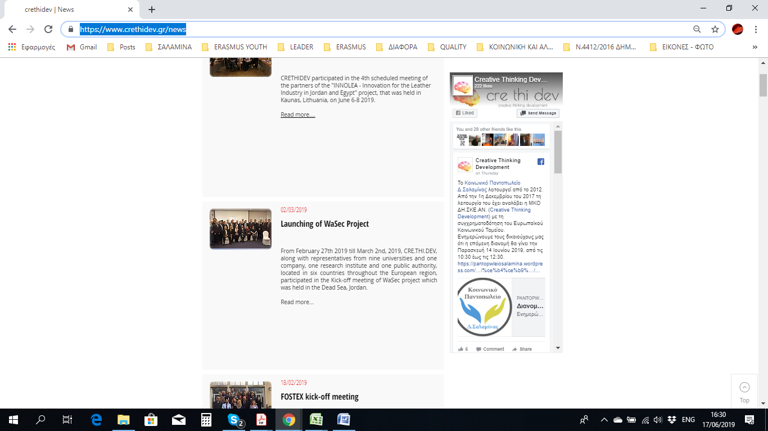
EVENT
The Press Release about the launching of the project (Kick off meeting) was posted in the website of CRE.THI.DEV (https://www.crethidev.gr/news)

Slide 8
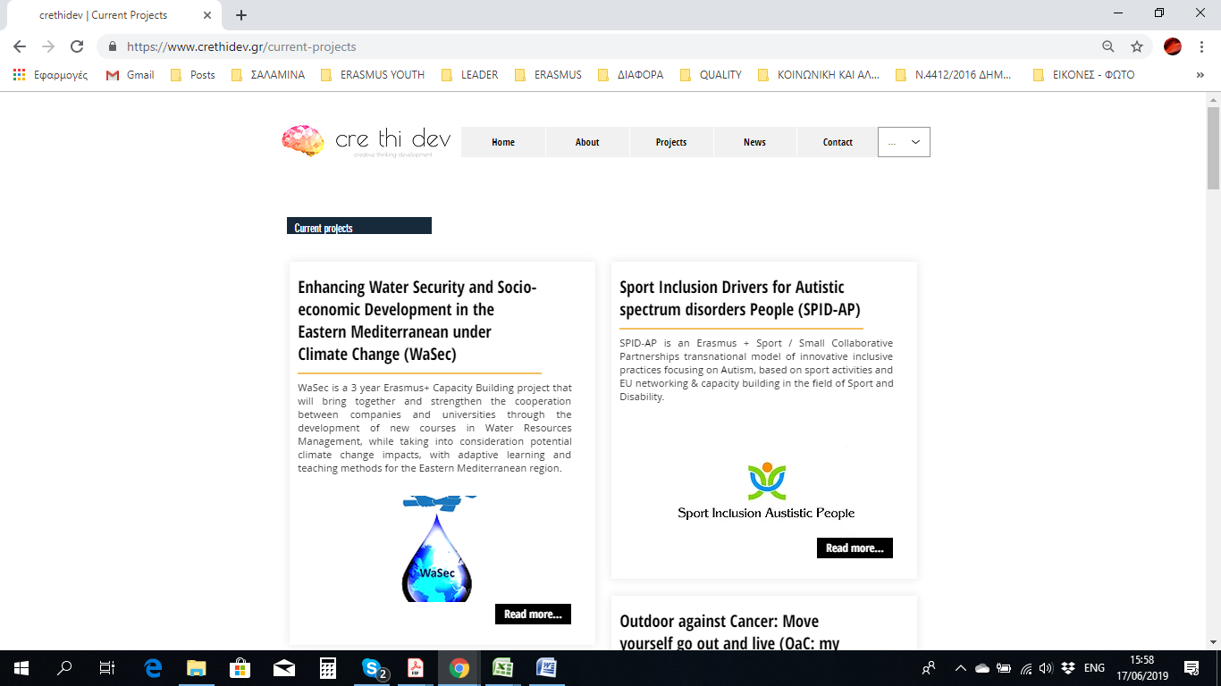
EVENT
A description of the objective of the project and its partners with reference to its website and social media was posted in the website of CRE.THI.DEV (https://www.crethidev.gr/current-projects)

Slide 9
EVENT
Invitation to Greek enterprises to answer the questionnaire for the survey
Αξιότιμη κυρία, αξιότιμε κύριε Η εταιρεία μας συμμετέχει στο έργο "Καινοτομίες στα Προγράμματα Εκπαίδευσης στον Τομέα της Διαχείρισης των Υδάτων: Ενίσχυση της Προστασίας των Υδάτων και της Κοινωνικοοικονομικής Ανάπτυξης στην Ανατολική Μεσόγειο στο πλαίσιο της Κλιματικής Αλλαγής" που συγχρηματοδοτείται από το πρόγραμμα ERASMUS+ της Ευρωπαϊκής Ένωσης. Βασικός στόχος του έργου είναι η προώθηση και η ενδυνάμωση της συνεργασίας μεταξύ Επιχειρήσεων και Πανεπιστημίων και η ανάπτυξη εκπαιδευτικών προγραμμάτων στα ΑΕΙ της Ιορδανίας και της Παλαιστίνης, που θα συνεισφέρουν στη σύνδεσή τους με τις ανάγκες της αγοράς και της ευρύτερης κοινωνίας στην περιοχή της Ανατολικής Μεσογείου (website: http://wasec.just.edu.jo) Βασική δράση του έργου είναι η διερεύνηση της κατάστασης όσον αφορά τη συνεργασία πανεπιστημίων και επιχειρήσεων στην Ανατολική Μεσόγειο. Θεωρώντας τη συνεισφορά της εταιρείας σας ιδιαίτερα σημαντική, σας προσκαλούμε να διαθέσετε λίγο χρόνο για να απαντήσετε το ερωτηματολόγιο που δημιουργήθηκε για το σκοπό αυτό και βρίσκεται στη δ/νση: https://forms.gle/EKtKHgrm5xNruALP6. Ευχαριστούμε εκ των προτέρων για τη συνεργασία σας.

Slide 10
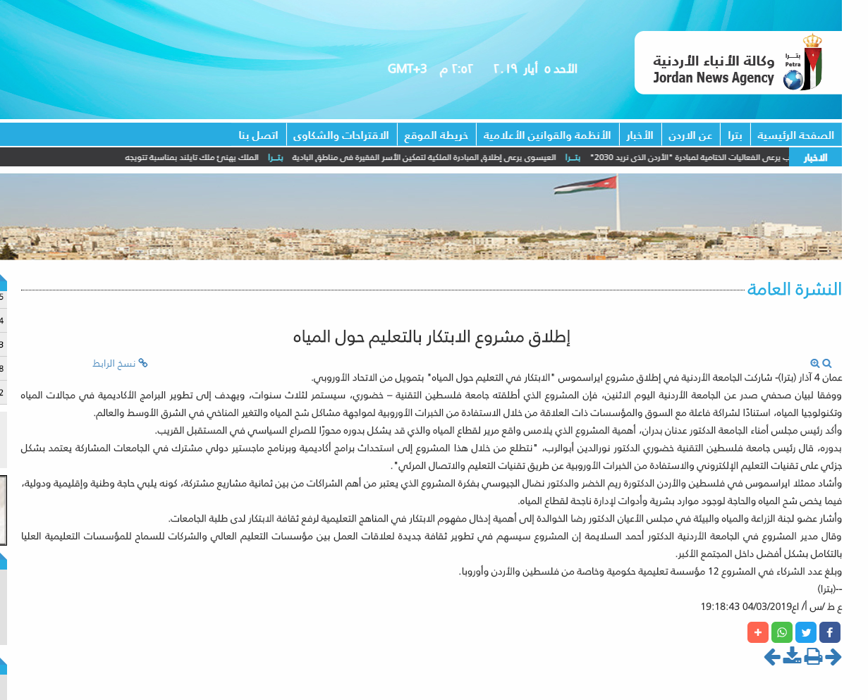
EVENT
Published on Petra news Agency (Monday, March 04, 2019)
Link: http://petra.gov.jo/Include/InnerPage.jsp?ID=93792&lang=ar&name=news

Slide 11
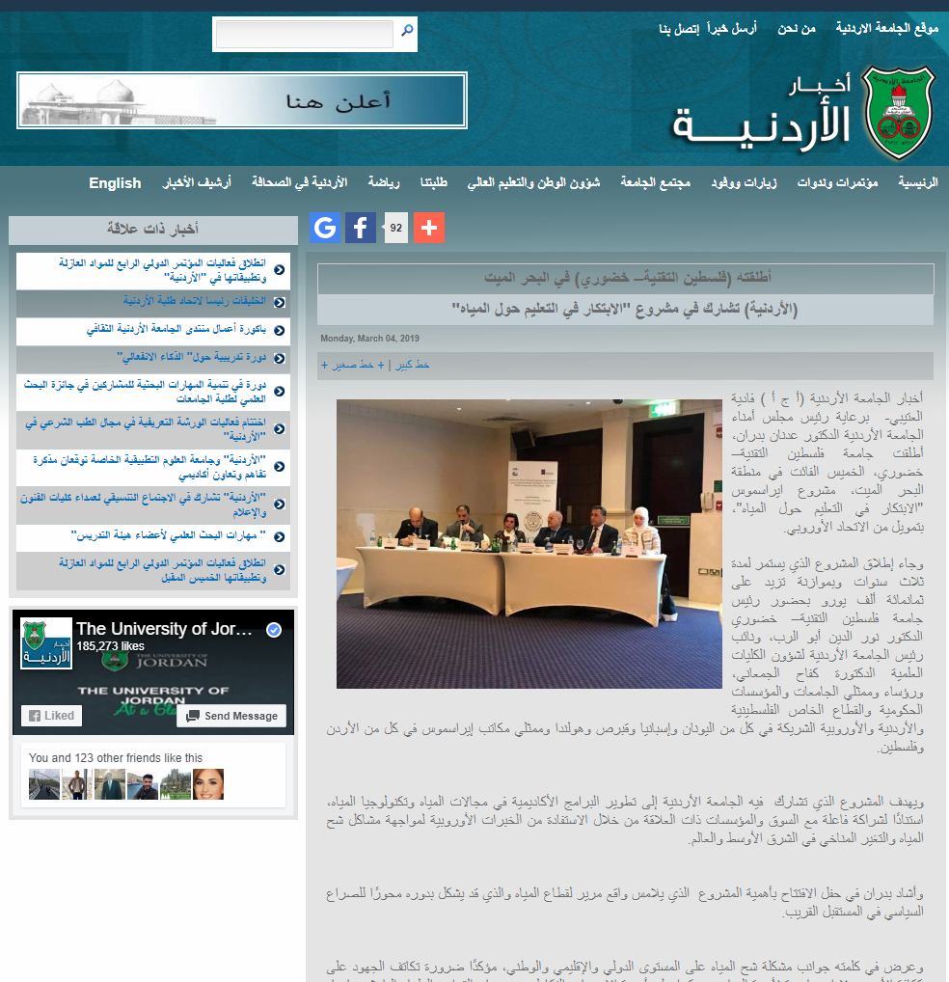
EVENT
2. Published on University of Jordan website (Monday, March 04, 2019)
Link: http://ujnews2.ju.edu.jo/Lists/News/Disp_FormNews1.aspx?ID=9902

Slide 12
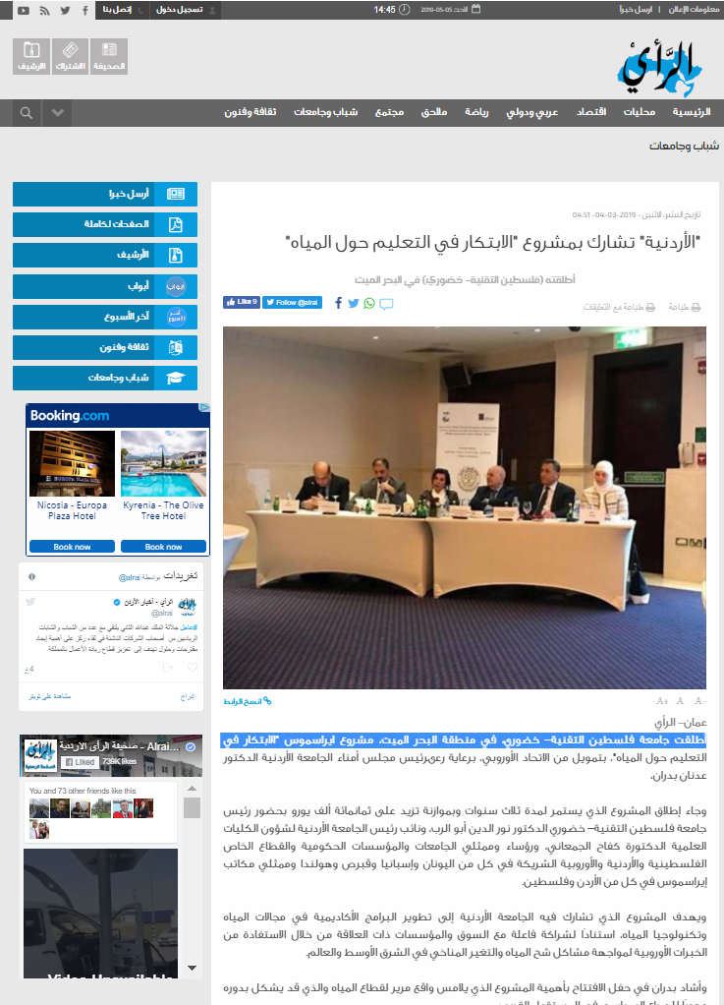
EVENT
3. Published on Alrai Newspaper website(Monday, March 04, 2019)
Link: http://alrai.com/article/10472836/%D8%B4%D8%A8%D8%A7%D8%A8- %D9%88%D8%AC%D8%A7%D9%85%D8%B9%D8%A7%D8%AA/%D8%A7%D9%84%D8%A3%D8%B1%D8%AF%D9%86%D9%8A%D8%A9-%D8%AA%D8%B4%D8%A7%D8%B1%D9%83-%D8%A8%D9%85%D8%B4%D8%B1%D9%88%D8%B9-%D8%A7%D9%84%D8%A7%D8%A8%D8%AA%D9%83%D8%A7%D8%B1-%D9%81%D9%8A-%D8%A7%D9%84%D8%AA%D8%B9%D9%84%D9%8A%D9%85-%D8%AD%D9%88%D9%84-%D8%A7%D9%84%D9%85%D9%8A%D8%A7%D9%87

Slide 13
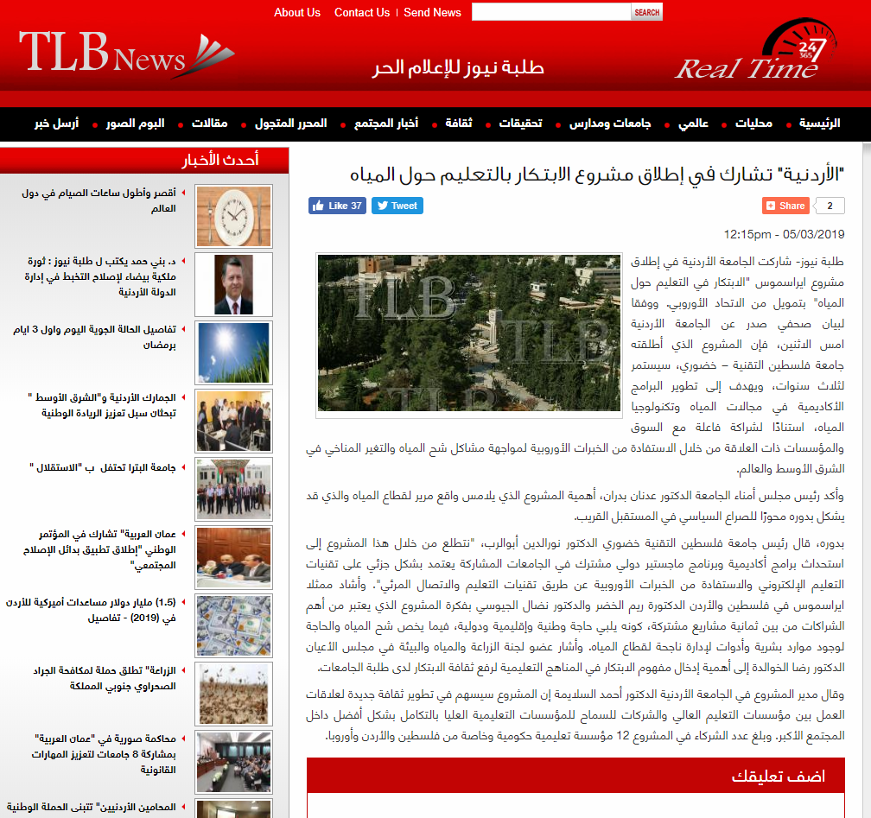
EVENT
Published on Talaba news (Tuesday, March 05, 2019)
Link: https://www.talabanews.net/ar/%D8%A7%D9%84%D8%A3%D8%B1%D8%AF%D9%86%D9%8A%D8%A9-%D8%AA%D8%B4%D8%A7%D8%B1%D9%83-%D9%81%D9%8A-%D8%A5%D8%B7%D9%84%D8%A7%D9%82-%D9%85%D8%B4%D8%B1%D9%88%D8%B9-%D8%A7%D9%84%D8%A7%D8%A8%D8%AA%D9%83%D8%A7%D8%B1-%D8%A8%D8%A7%D9%84%D8%AA%D8%B9%D9%84%D9%8A%D9%85-%D8%AD%D9%88%D9%84-%D8%A7%D9%84%D9%85%D9%8A%D8%A7%D9%87#.XM7NzWgzaF4

Slide 14
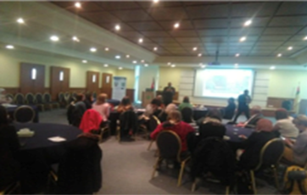
EVENT
Dissemination Event During the “Window of Collaboration" , April 2019
Jordan-Amman 17, April, 2019 Jordan university of Science and technology participated in the dissemination activity for the WaSec project at the Info day “ Window of Collaboration” which was organized at UJ.

Slide 15
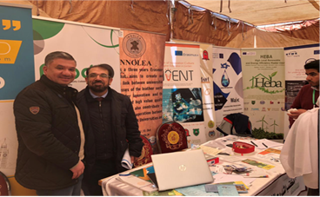
EVENT
Dissemination activity for the WaSec project at the Job Fair and Info Day, April 2019
Jordan-Irbid/Al Ramtha 22,April,2019 Dissemination activity for the WaSec project at the Job Fair and Info day which was organized at JUST. More than 2000 persons attended.

Slide 16
EVENT
Dissemination activity for the WaSec project at ALChE, April 2019
Jordan-Irbid/Al Ramtha 22, April, 2019 Dissemination activity for the WaSec project at AIChE conference and Info day which was organized at JUST. More than 200 teachers and students attended from different universities and from Al Najah University/ Palestine.

Slide 17

EVENT
Dissemination activity for the WaSec project at the Third Agriculture Exhibition, April 2019
Jordan_Irbid/ Al Ramtha 24,April,2019 Dissemination activity for the WaSec project at the Third Agriculture Exhibition and Info day which was organized at JUST on April 24, 2019.​

Slide 18
Thanks

